Slide 1
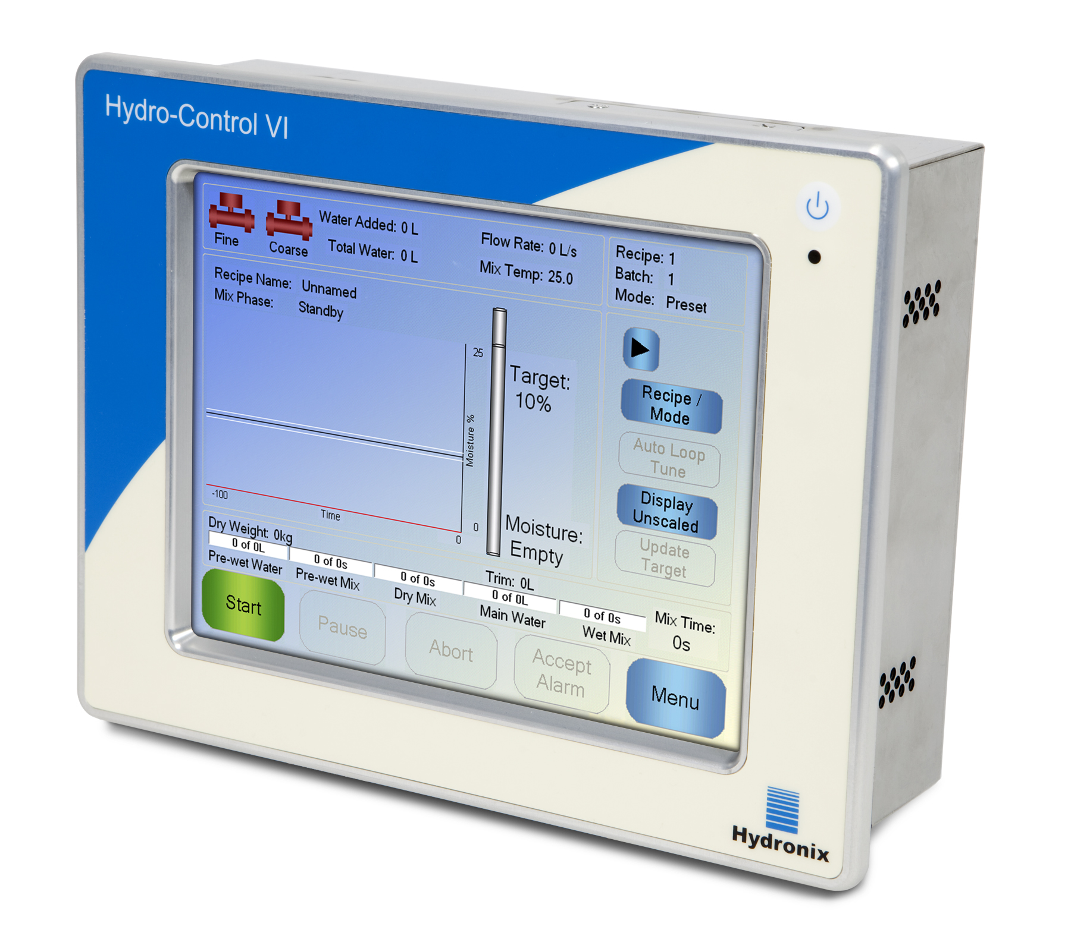
Hydro-Control VI
Fully automatic water control system
21,3cm LCD Colour Touchscreen
Multitasking-System
USB-Interface for Data exchange
3 modes – PRESET/CALCULATION/AUTO
Water scales can be controlled
Easy installation and exchange
Control of 2 water valves (Coarse and Fine)
Graphical trend display of the last 1000 batches
Special modes for admix handling available
Progressive waterr addition with new PID-Algorithm

Slide 2
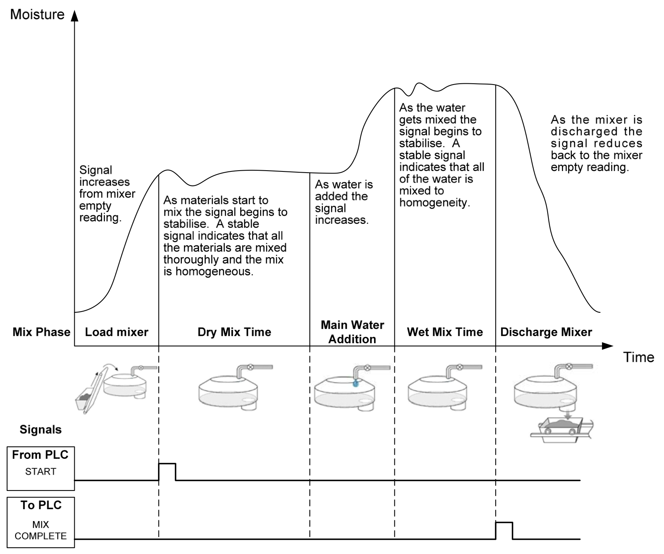
Hydro-Control VI
Mixing Basics
A simple mix cycle

Slide 3
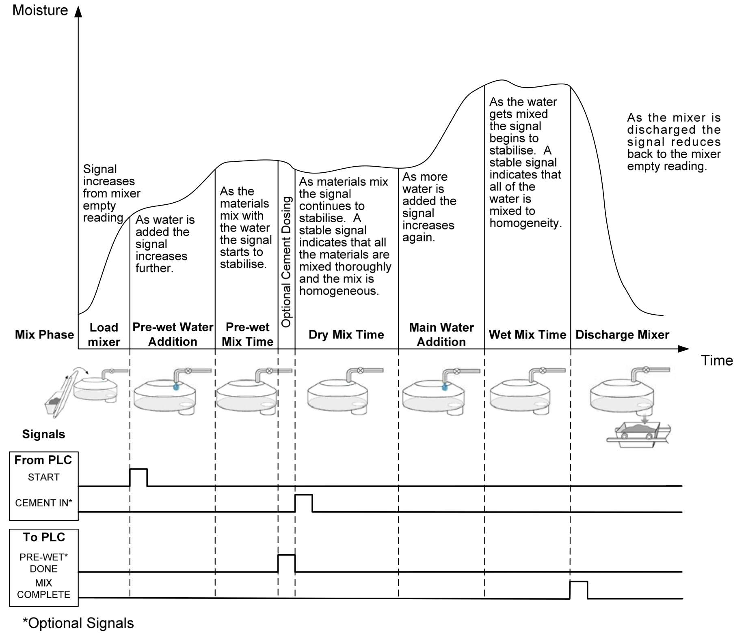
Hydro-Control VI
Mixing Basics
A mix cycle with
Prewet water

Slide 4
Hydro-Control VI
Water addition modes
The Hydro-Control VI can be used in
a manual preset mode
and 2 different automatic water addition modes:
The Calculation Mode
The Auto Mode

Slide 5
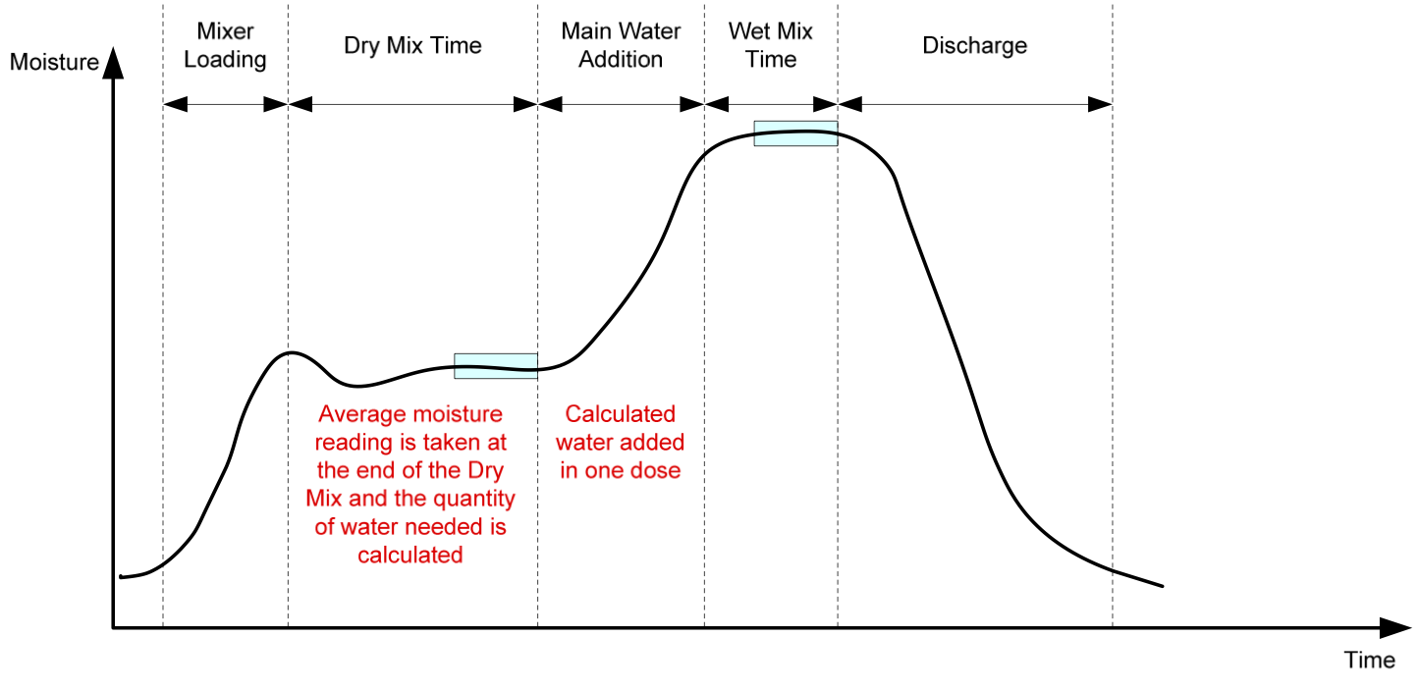
Hydro-Control VI
The Calculation mode
In this mode the Hydro-Control VI uses the dry mix period to measure the moisture of the dry mix, compare this with the target value and add this calculated quantity in one shot.

Slide 6
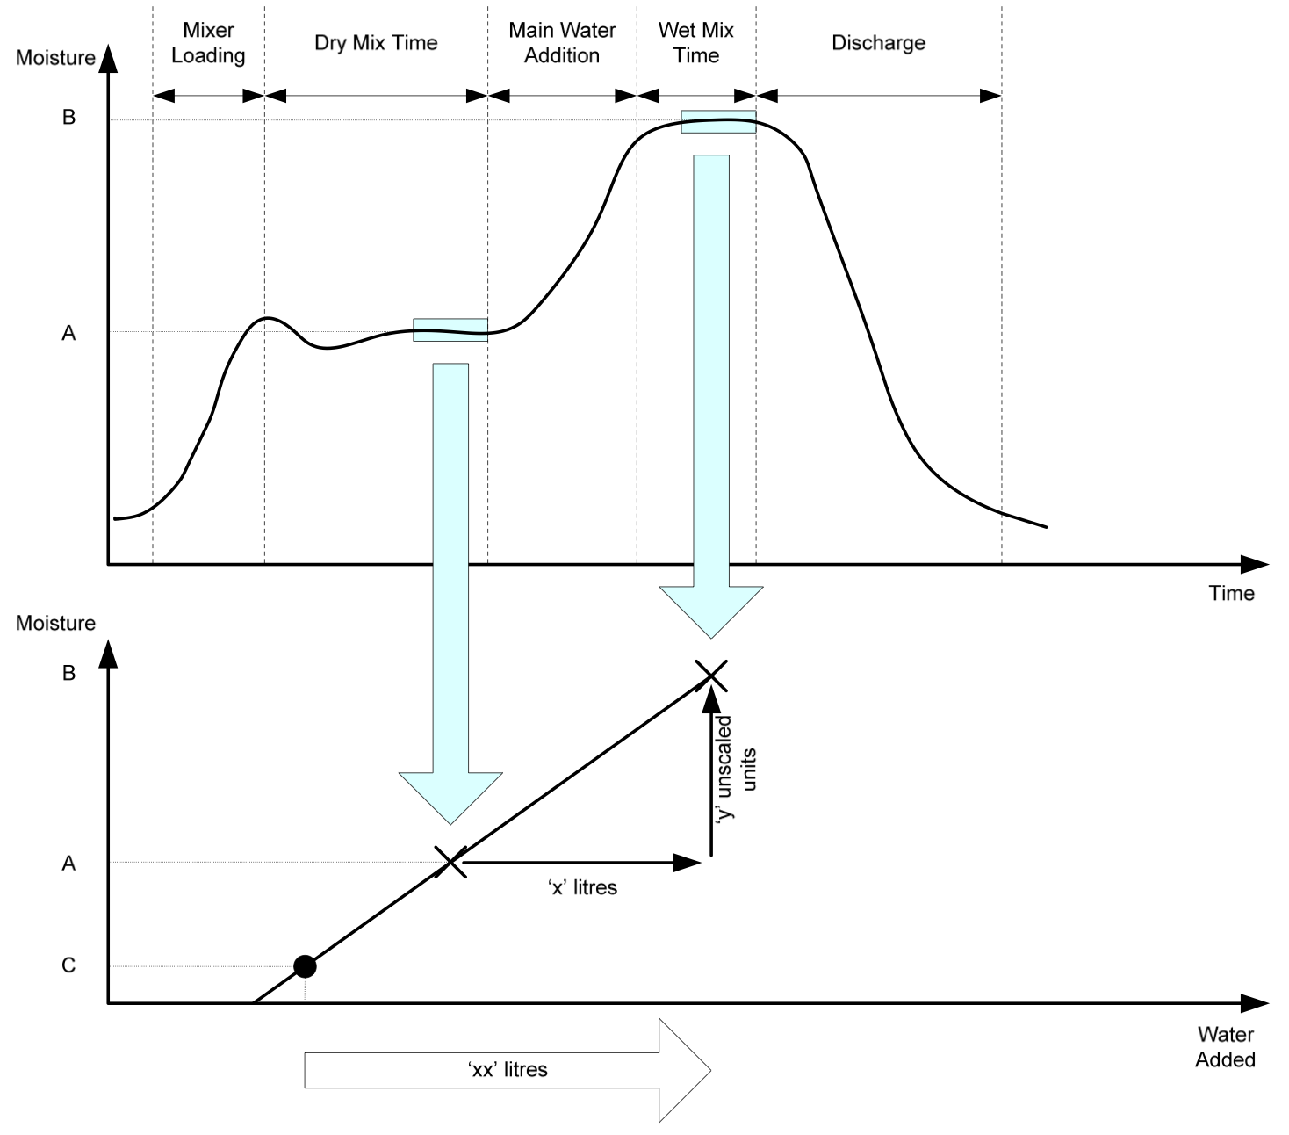
Hydro-Control VI
The Calculation mode
How does the recipe calibration work?
A batch will be done with a fixed amount of water in Preset mode
At the end of the dry mix time the Hydro-Control VI stores the internal unscaled value.
The water will be added.
After water addition wait for a stable signal.
Check if the mix is OK.
Add more water if necessary and wait for a stable signal.
Finish the batch.
Open the mixlog, choose the last batch and calibrate.
The Hydro-Control uses the given moisture and knows the Unscaled value of the final batch. (M2 and U2).
The moisture difference is the added water divided by the dry weight.
The dry moisture is now target – moisture difference = M1
The stored unscaled value U1 is now used with M1.

Slide 7

Hydro-Control VI
The Calculation mode

Slide 8
Hydro-Control VI
The Calculation mode
The calibration procedure

Slide 9
Hydro-Control VI
The Calculation mode
The recipe has now been recalibrated to reach a target value of 7,2%.
The system will calculate the water like before but will reach the target of 7.2% with 2,5 litres of water less.
This -2,5L Trim is now part of the new calibration line.

Slide 10
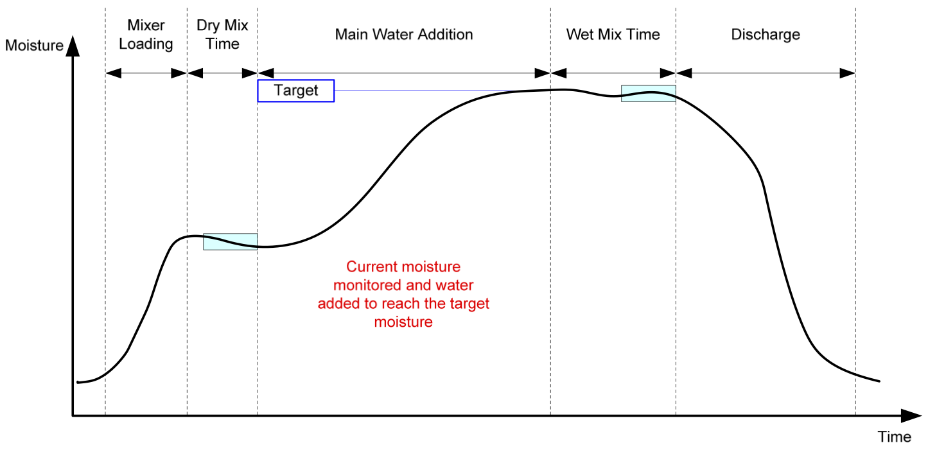
Hydro-Control VI
The AUTO mode
In this mode the Hydro-Control VI uses only a short dry mix time and then starts to add the water progressively until the final target value will be reached.
The AUTO mode does not need a calibration procedure like the Calibration mode as it will add water until the final reading has been reached.

Slide 11
Hydro-Control VI
The AUTO mode

Slide 12
Hydro-Control VI
The AUTO mode

Slide 13
Hydro-Control VI
The AUTO mode
Optimisation of the Auto mode
The AUTO mode is using 3 parameters. A Propotional, an Integral and a Derivative Gain. (PID Controller).
In most mixer application it is only necessary to change the Propotional Gain.
The Proportional Gain is the standard paramter to optimise the system speed. A higher number means the system adds the water faster.
It can be adjusted at any time and then changes will work instantly.
As can be seen from the figure. If the Proportional Gain is set too high then the moisture will overshoot the target value. If the Proportional Gain is set too low then the water is added too slowly and the moisture will take too long to get to the target value.
The Proportinal Gain

Slide 14
Hydro-Control VI
The AUTO mode
The Integral Gain will act to increase the water flow depending on the length of time that has passed. This can be used to correct the addition when the moisture tails off after the initial water addition.
The Integral Gain

Slide 15
Hydro-Control VI
The AUTO mode
The Derivative Gain
The Derivative Gain only needs to be changed if there is overshoot on the target that settles as the water is mixed in.

Slide 16
Hydro-Control VI
The Auto-Track function
The Auto-Track function helps you on optimising your mixing time automatically.
It checks continiously if the moisture signal change is within a defined bandwidth. Should it vary more than allowed by the settings the system will automatically extend the mixing time to ensure that the concrete is homogenously mixed.

